Slide 1


Next Hikes IT Solutions Project-4 Feature Extraction and Price Prediction for Mobile Phones Using Machine Learning Presented By:-Ashish Kumar Sen

Slide 2

Introduction
In a rapidly evolving mobile market, consumers want accurate pricing information, and businesses need to set competitive prices to stay ahead.

Slide 3

Why Mobile Price Prediction?
Manual price prediction is time-consuming and prone to errors. Machine learning provides a systematic and efficient way to analyze vast amounts of data for accurate predictions.

Slide 4

Objective
Our objective is to demonstrate the impactful utilization of machine learning algorithms in predicting mobile phone prices accurately. This initiative aims to benefit both consumers and businesses alike.
We aim to construct a robust predictive model capable of precisely estimating the price of a mobile phone by analyzing its features. To achieve this, we will conduct a thorough feature extraction analysis to identify and leverage the most influential features in the prediction process.
Primary goal is to develop a predictive model for mobile phone prices.

Slide 5
Process
Pre Processing & Data Cleaning
Exploratory Data Analysis [EDA]
Train Data
Train – Test
Split
Test Data
Linear Regression
Apply Machine Learning Techniques
Decision Tree
Validating the results
Random Forest Regressor
Exploratory Analysis with Optimal training results
Gradient Boosting

Slide 6
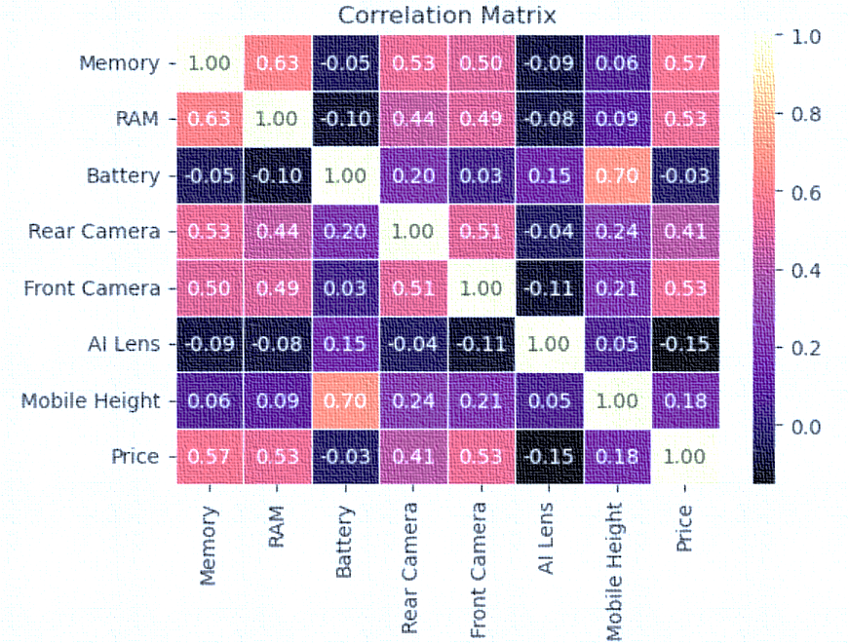
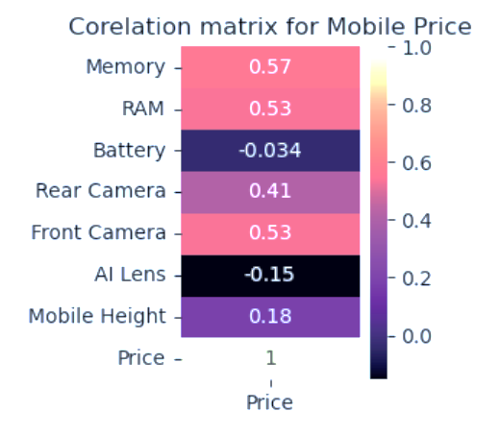
Correlation matrix
The correlation coefficient ranges from -1 to +1. When it is close to +1 it is positively correlated. The Mobile Height, Battery, Memory and RAM are highly correlated.
The correlation matrix for Mobile price is highly correlated with Memory, RAM & Front Camera
This implies that as the RAM and Memory specifications increase, the price of the mobile device tends to increase as well

Slide 7
ARALYZING RELATIONSHIP WITH PRICE
Values in MINR
MEMORY VS PRICE
RAM VS PRICE
BATTERY VS PRICE
If the memory capacity is 128 GB, the associated price is higher. However, for memory capacities less than or greater than 128 GB, the pricing consistently decreases
As the RAM capacity increases, there is a corresponding increase in the price
Battery Capacity falls within the range of 5000 mAh, the pricing trends to be higher

Slide 8

Model building visualization using different algorithm
Linear Regression
Decision Tree
Random Forest
Gradient Boosting

Slide 9
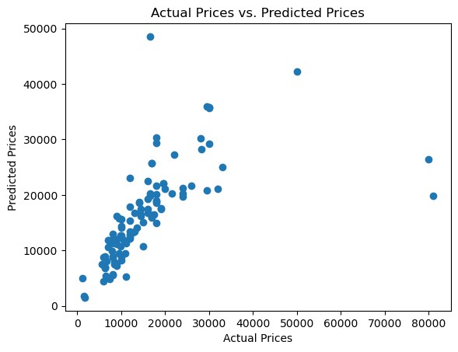
Linear regression
Definition:
Linear regression is a statistical method used for modeling the relationship between a dependent variable and one or more independent variables by fitting a linear equation to the observed data
Model Performance:
Mean Absolute Error- 4282.96
Mean Squared Error- 86048442
R-Squared : 37%
Conclusion:
Mean Absolute Error and Mean Squared Error point to a moderate level of accuracy, the low R-squared value suggests that the model may not effectively explain the variance in the data

Slide 10
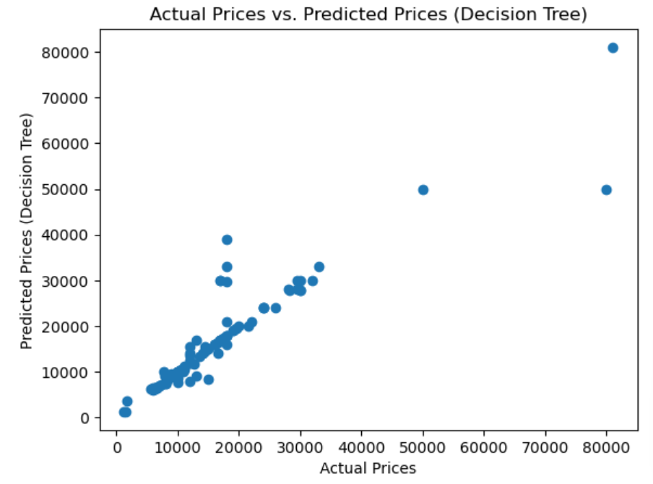
Decision tree regression
Definition:
Decision Tree Regression is a machine learning algorithm used for predicting numerical values based on input features. Unlike decision trees used for classification, where the aim is to assign data points to discrete classes, decision tree regression focuses on predicting a continuous output
Model Performance:
Mean Absolute Error- 1543.211
Mean Squared Error- 20300
R-Squared : 85.2%
Conclusion:
The decision tree model seems to have a strong predictive performance overall, as suggested by the high R-squared value

Slide 11
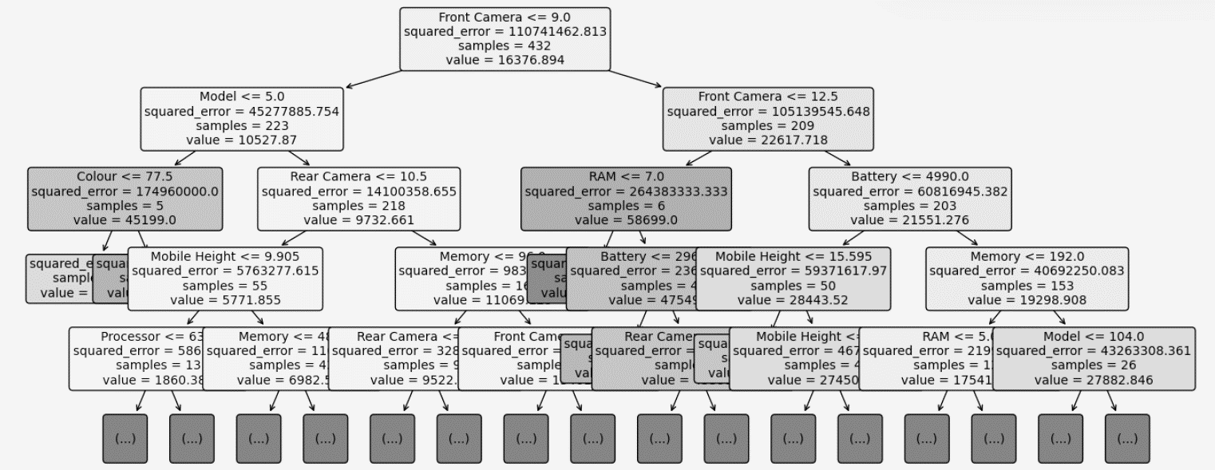
Decision tree structure

Slide 12
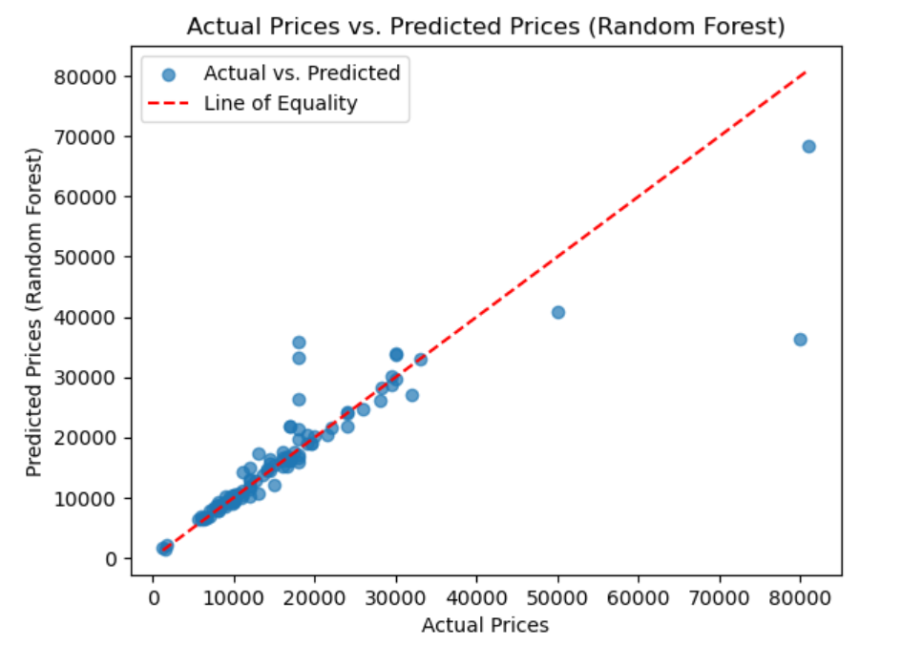
Random forest regression
Definition:
Random Forest Regression is an ensemble learning technique based on the concept of combining multiple decision trees to improve the overall predictive performance and robustness of a regression model. It is an extension of the decision tree algorithm and belongs to the broader class of ensemble methods
Model Performance:
Mean Absolute Error- 1857.60
Mean Squared Error- 27394079
R-Squared : 80.12%
Conclusion:
A relatively high R-squared value indicating a strong fit to the data. However, the substantial Mean Squared Error suggests the presence of instances with larger prediction errors

Slide 13
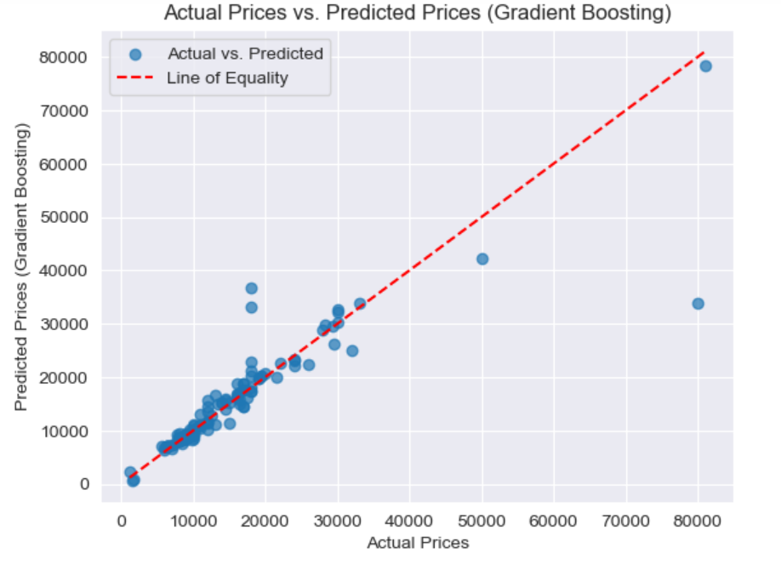
Gradient boosting regression
Definition:
Gradient Boosting regression builds a predictive model in a stage-wise fashion by combining the predictions of multiple weak learners, typically decision trees, to create a strong predictive model
Model Performance:
Mean Absolute Error- 1934.037
Mean Squared Error- 27962073
R-Squared : 79.71%
Conclusion:
This model provides reasonably accurate predictions, as suggested by the R-squared value. However, the relatively high Mean Absolute Error and large Mean Squared Error hint at potential challenges, possibly due to outliers or other factors influencing prediction accuracy

Slide 14
Best Fitted Model
Decision Tree
Random Forest
Gradient Boosting
Accuracy
85.2%
Accuracy
80.12%
Accuracy
79.71%

Slide 15

Price prediction using decision tree
INPUT BASED ON FEATURE IMPORTANCE NEW_MOBILE_1
FEATURE | ASSUMPTION VALUES
MODEL | 547
COLOUR | 10
MEMORY | 128
RAM | 8
BATTERY | 4700
REAR CAMERA | 64
FRONT CAMERA | 16
AI KENS | 0
MOBILE HEIGHT | 16.36
PROCESSOR | 547
INR.12,999/-

Slide 16

Price prediction using decision tree
INPUT BASED ON FEATURE IMPORTANCE NEW_MOBILE_2
FEATURE | ASSUMPTION VALUES
MODEL | 621
COLOUR | 2
MEMORY | 128
RAM | 4
BATTERY | 4323
REAR CAMERA | 12
FRONT CAMERA | 12
AI KENS | 0
MOBILE HEIGHT | 17.02
PROCESSOR | 621
INR.80,999/-

Slide 17


